Slide 1
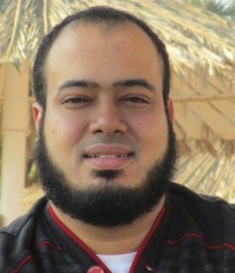
Competitive Programming From Problem 2 Solution in O(1)
P
T
H
I
N
K
F
A
S
T
S
C++: Pointers-1
Mostafa Saad Ibrahim
PhD Student @ Simon Fraser University

Slide 2
Pointers
So far we are using variables.
These variables exist in the memory
This is the common in any high-level langauge
Through pointers, we can directly interact with the memory
In addition, we can do pointers arthimatic (e.g. Incremet pointers to some location)

Slide 3
Pointers
It is intersting topic
It is tricky topic
You need to play a lot
Draw whenever confused.

Slide 4
Recall
Bit = 0 or 1
Byte = 8 bits => Memroy block size
Char = 1 byte
Int = 4 bytes
Long Long = 8 bytes
C++ allow you control over even bit level
Note: some v# bits alues may change from architecture to another

Slide 5
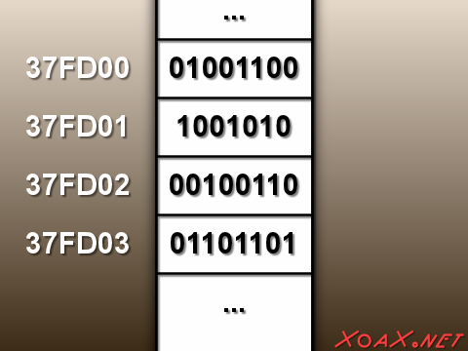
Recall: Memory Address
Memory
consists of
byte-sized locations
Variable
has
address
Bits are 0 or 1
Anything finally
Is bit
Regardless
int, char, or more
Notes:
Src: http://xoax.net/comp_sci/crs/architecture/lessons/Lesson2/

Slide 6
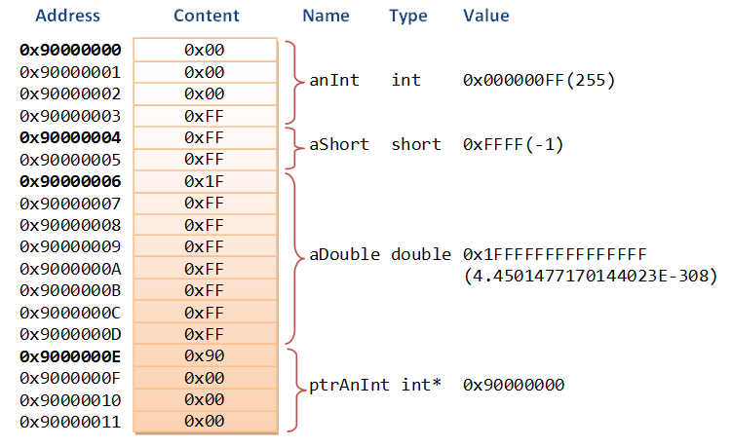
Recall: Memory Address
Notes:
Src: https://www.it-gems.com/wp-content/uploads/2013/10/MemoryAddressContent.png

Slide 7
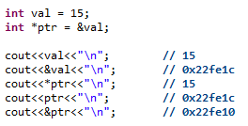
Pointer: Declare – Intialize - Draw
ptr= 0x22fe1c
val = 15
0x22fe10
0x22fe1c
ptr or val => get content of this variable
&ptr or &val => get address of this variable
*ptr => get content of the variable whose address is stored in ptr => indirect addressing
*: unary operator named: dereference operator.

Slide 8
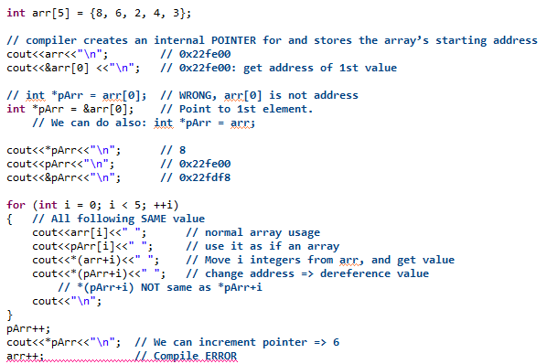
Pointers and Arrays

Slide 9
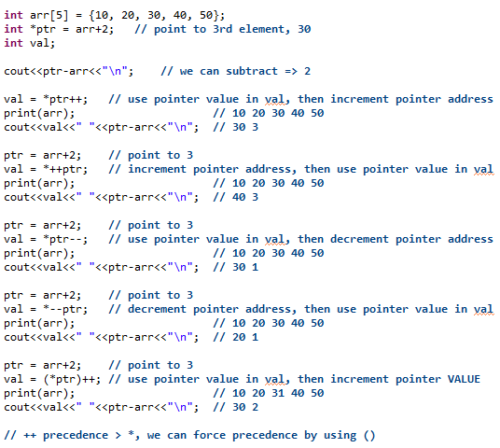
Pointers Arithmatic

Slide 10
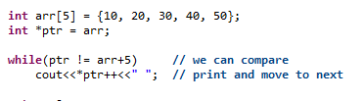
Pointers Arithmatic

Slide 11
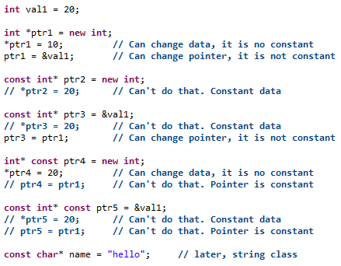
Const and Pointers

Slide 12
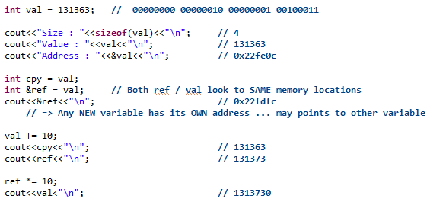
Variable Alias

Slide 13
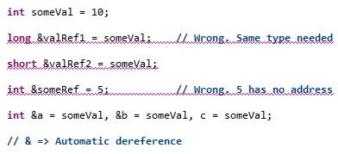
Variable Alias

Slide 14
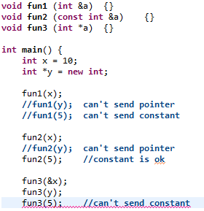
Paremter: Alias vs Pointer

Slide 15
تم بحمد الله
علمكم الله ما ينفعكم
ونفعكم بما تعلمتم
وزادكم علماً

